Slide 1

Swiggy Data Analysis
Mujahid Raza

Slide 2
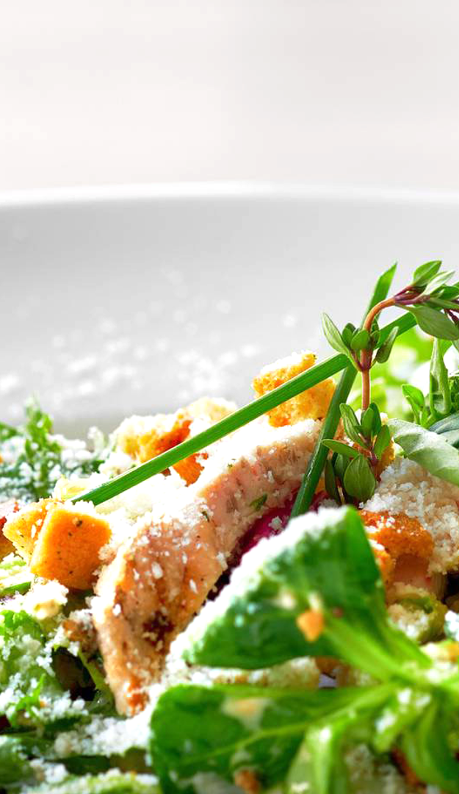
INTRODUCTION
The online food ordering market includes foods prepared by restaurants, prepared by independent people, and groceries being ordered online and then picked up or delivered. The first online food ordering service, World Wide Waiter (now known as Waiter.com), was founded in 1995. Online food ordering is the process of ordering food from a website or other application. The product can be either ready-to-eat food or food that has not been specially prepared for direction consumption.

Slide 3
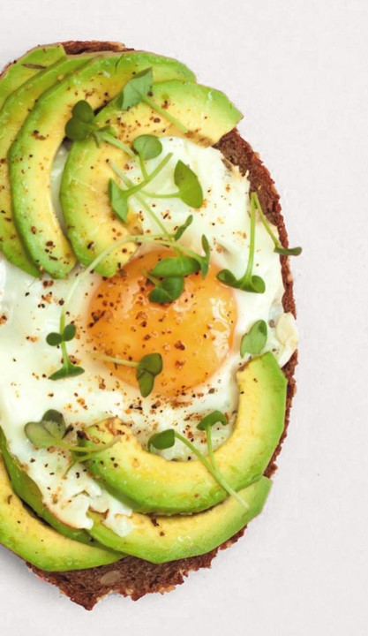
OBJECTIVE
OBJECTIVE :-
In the world of rising new technology and innovation, Food industry is advancing with the role of Data Science and Analytics. Data analysis can help them to understand their business in a quiet different manner and helps to improve the quality of the service by identifying the weak areas of the business.
BENEFITS :-
Help out to make better business decisions.
Help analyze customer trends and satisfaction, which can lead to new and better products and services.
Gives better insight of customers base.
Helps in easy flow for managing resources.

Slide 4
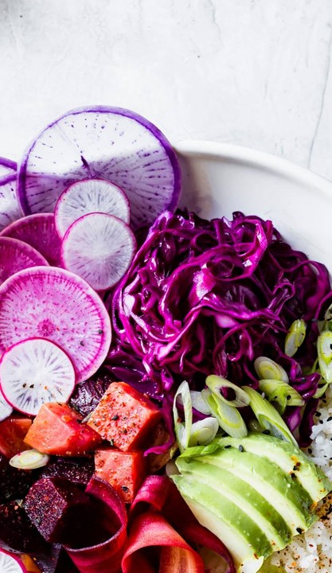
Problem Statement
Food industries are having important reflection of the economy from past few decades. Online food ordering is the process of ordering food from a website or other application. The product can be either ready-to-eat food or food that has not been specially prepared for direction consumption.
In this project, we are analyzing the various aspects with different use cases which covers many aspects of Swiggy Food Delivery Service. It helps in not only understanding the meaningful relationships between attributes, but it also allows us to do our own research and come-up with our findings.

Slide 5
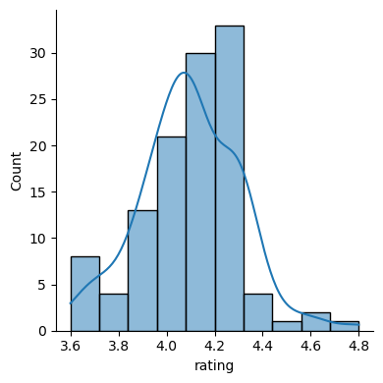
Distribution of Rating :-
Conclusion :
From this Distribution Plot, We can conclude that More that '50%’ of Restaurants are having a Rating greater than"4.1"with a Maximum Rating of "4.8“ which is considered as a decent Rating.

Slide 6
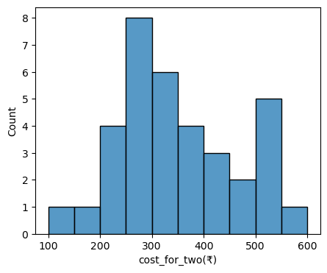
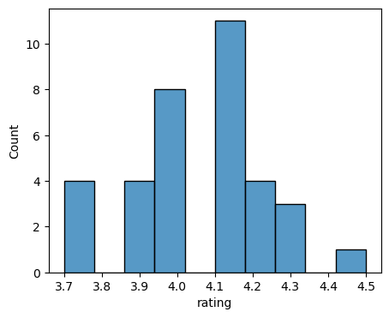
Area wise Cost and Rating :
Conclusion :
BTM Area :
From this you can produce Various Conclusions like–
BTM : Most has 4.0 to 4.2 Rating and Approx. Cost for Two People lies between 200 to 350 .(Max. Cost goes up to 600)

Slide 7
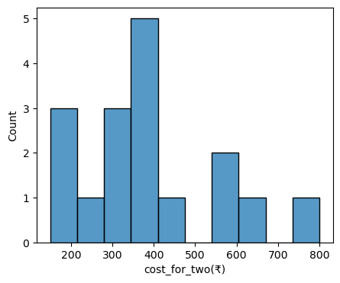
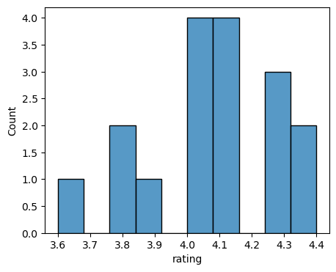
HSR Area :
Conclusion :
From this, you can produce Various Conclusions like–
HSR : Most has 4 or above Rating and Approx. Cost for Two People lies between 300 to 400. (Max. Cost goes up to 800)

Slide 8
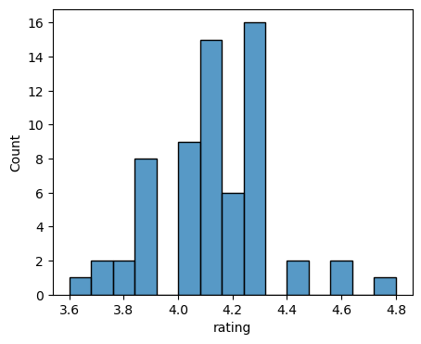
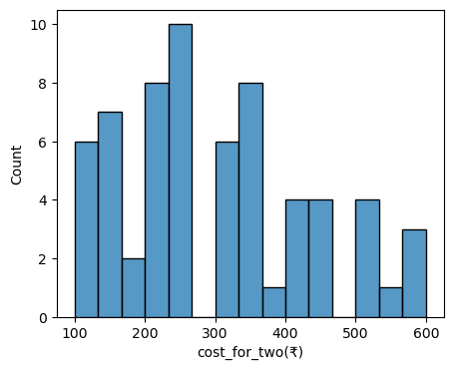
Koramangala Area :
Conclusion :
From this, you can produce Various Conclusions like–
Koramangala : Most has 4.0 to 4.3 Rating and Approx. Cost for Two People lies between 200 to 350. (Max. Cost goes up to 600)
With this we can conclude the Most Costly Area is HSR.

Slide 9
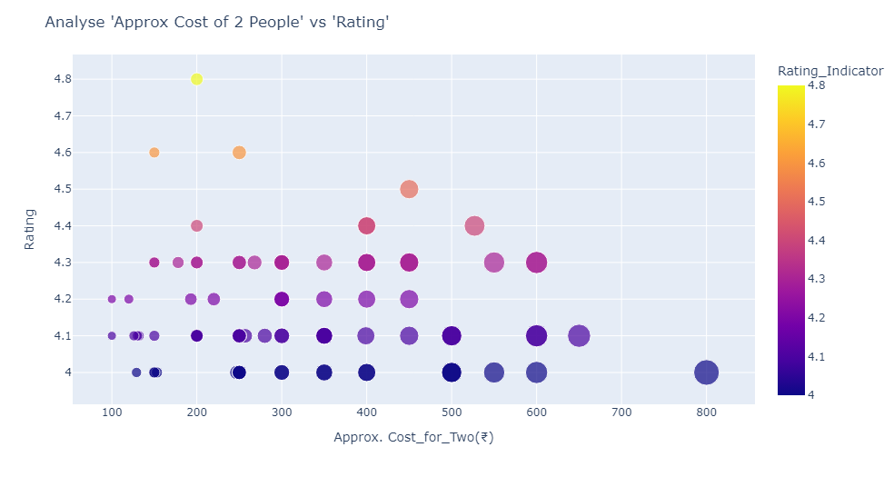
Relationship between Rating and Cost :-
Conclusion :
Most of the Affordable/Budgeted Restaurants are having Excellent Rating as well.
Same we can see, For Approx. Cost of "200", "150", "250", and "450", The Ratings were "4.8", "4.6", and "4.5“ respectively.
This might be because Most of the people prefer Affordable/Budget Restaurants which also provides good quality of Cuisines.
On the other hand, There are few Expensive Restaurants who doesn’t have that much Rating and they are Expensive.
Restaurants which Costs around "600“ to " 800“ for Two People are having the Ratings in between '4.0’ to '4.1’ which Is too less as compared to Affordable/Budgeted Restaurants.

Slide 10
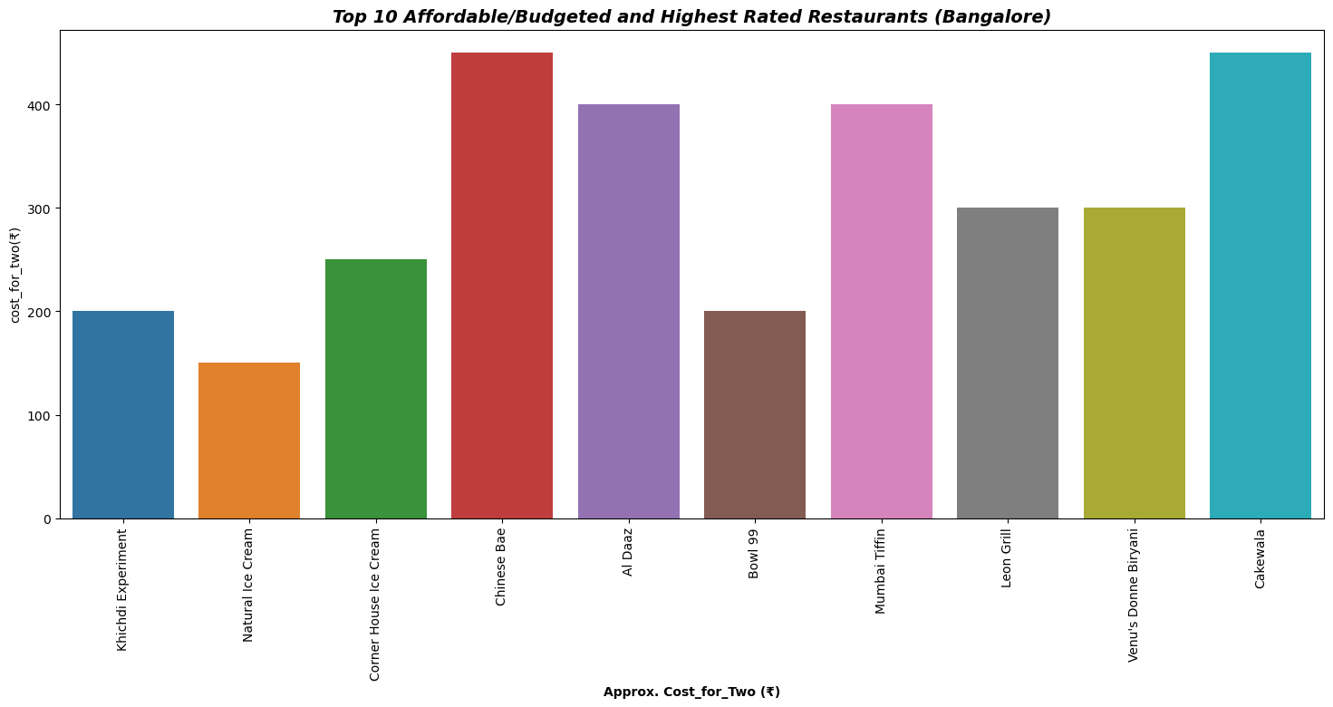
Top 10 Highest Rated Restaurants :
Conclusion :
This beautiful "Bar Chart“ displays all the Affordable/Budgeted and Highest Rated Restaurants available in the entire Bangalore Area.

Slide 11
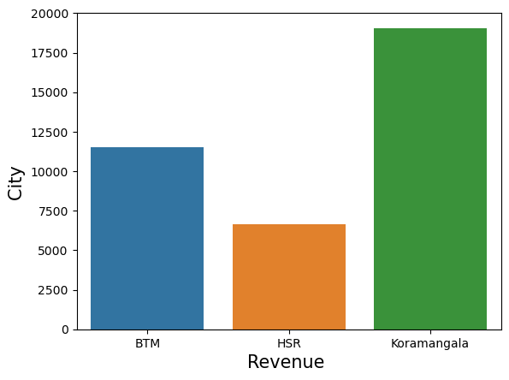
Revenue in each Area :-
Conclusion :
From the Visualizations, We can say Koramangala has most Revenue followed by BTM Area and HSR Area.

Slide 12
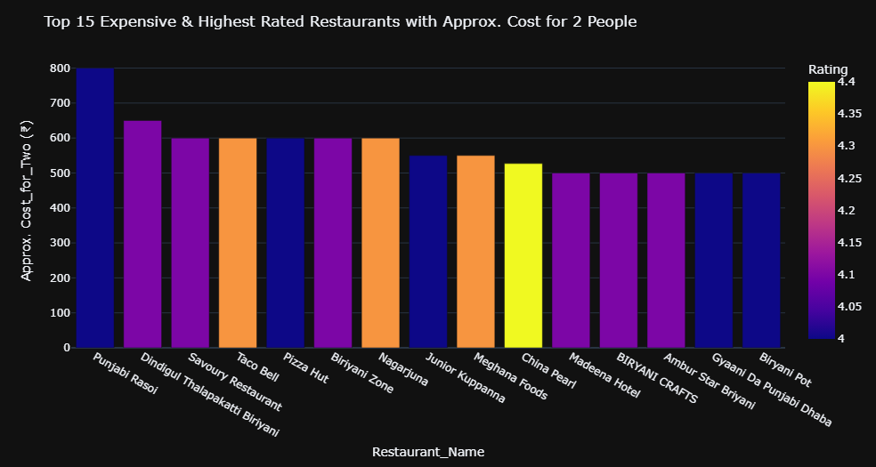
Top 15 Expensive & Highest Rated Restaurants with Approx. Cost for 2 People :
Conclusion :
Punjabi Rasoi is the Highest cost for two people and China Pearl has Highest Rating.

Slide 13
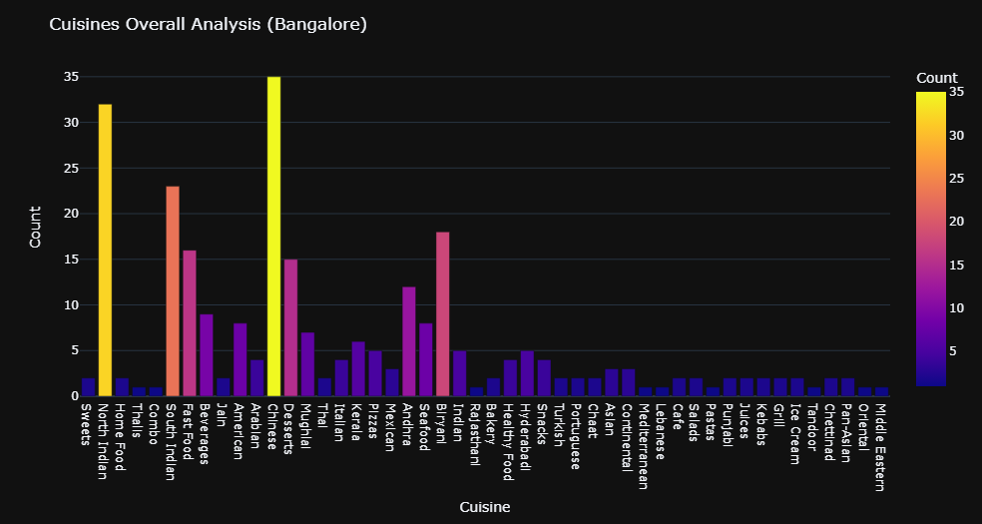
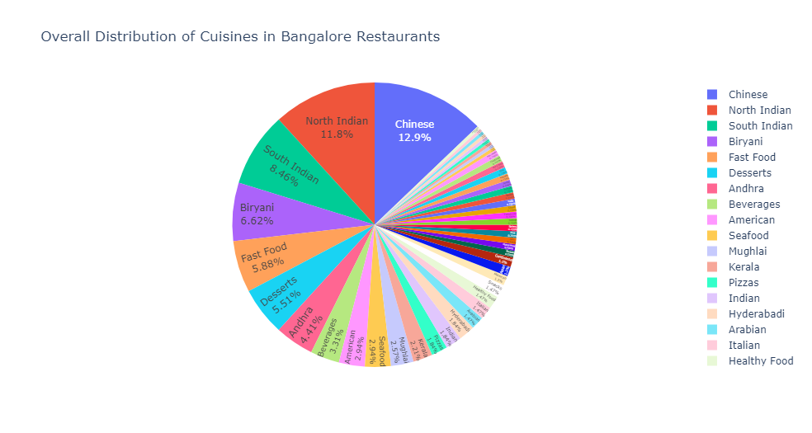
Cuisine Analysis
Overall Distribution of Cuisine :
Conclusion :
From the above Visualizations, We can say, Most of the Restaurants sell "Chinese“ which is around '12.9%’ followed by "North Indian“ & "South Indian“ Cuisines which are around '11.8%’ & '8.46%'.
So, We can also infer that Most of the people are fond of these Cuisines.

Slide 14
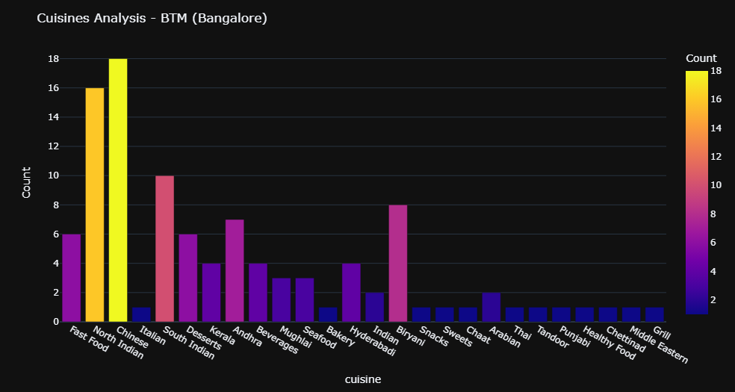
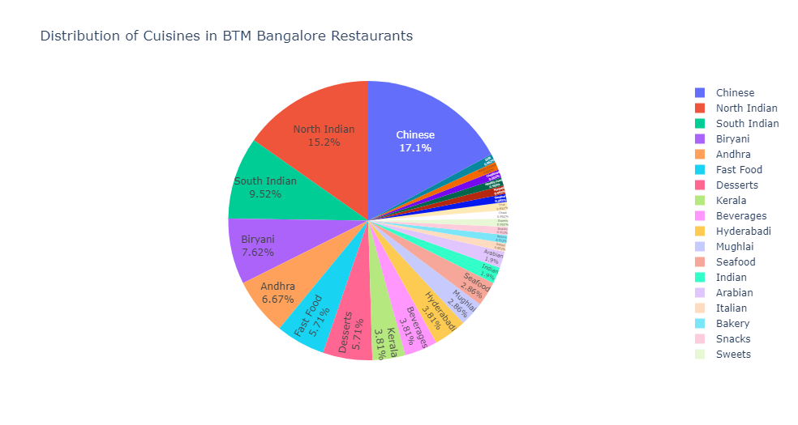
Distribution of Cuisine in BTM Area :
From the above Visualizations, We can say, In BTM Area, Most of the Restaurants sell “Chinese“ which is around '17.1%’ followed by "North Indian“ & "South Indian“ Cuisines which are around '15.2%’ & '9.52%'.
Most of the people are fond of these Cuisines.
Conclusion :

Slide 15
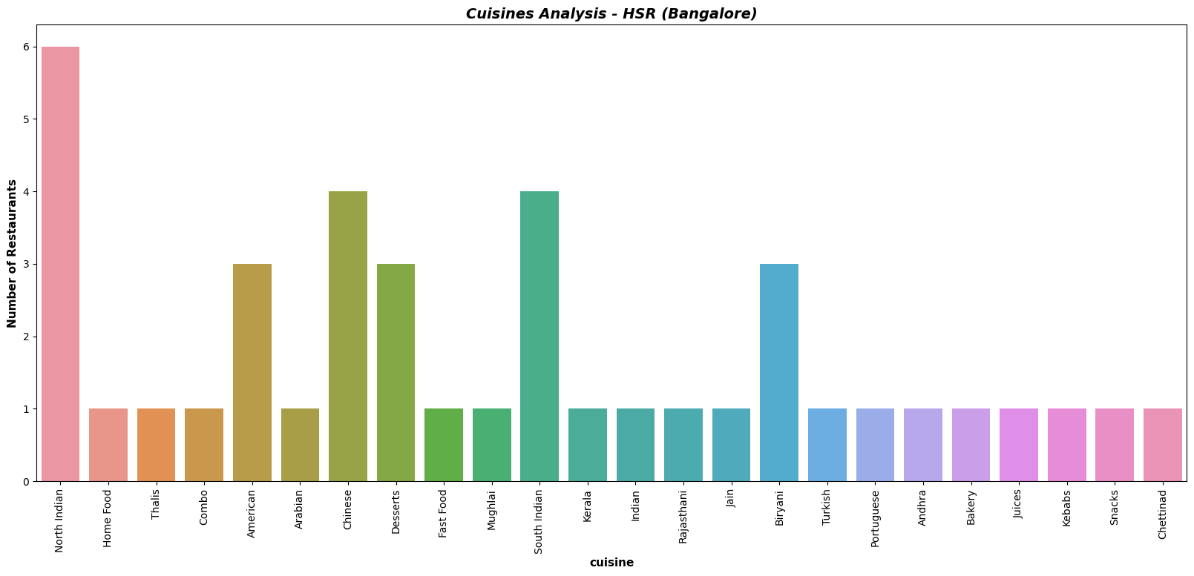
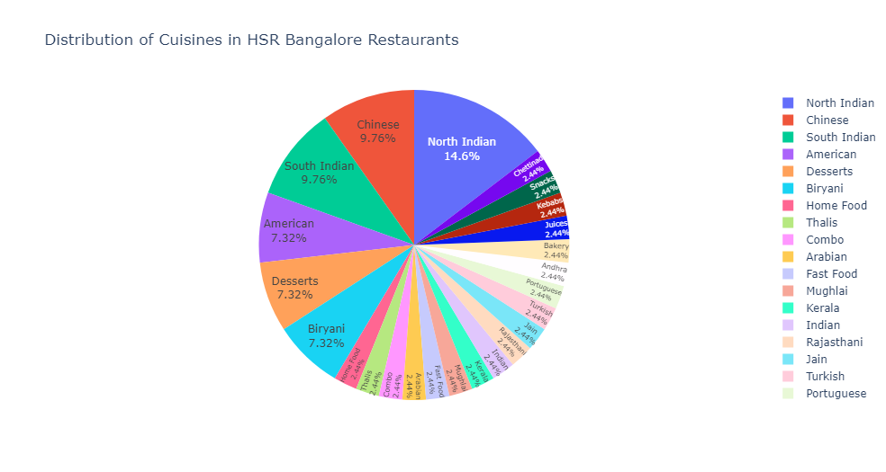
Distribution of Cuisine in HSR Area
From the above Visualizations ,We can say, In HSR Area, "North Indian“ Cuisines are dominated by around '14.3%’ followed by
"Chinese“ & "South Indian“ Cuisines '9.52% '& '9.52%’ of Restaurants respectively.
So, We can also infer that-In HSR Area, We may have more "North Indian“ people staying there.
Conclusion :

Slide 16
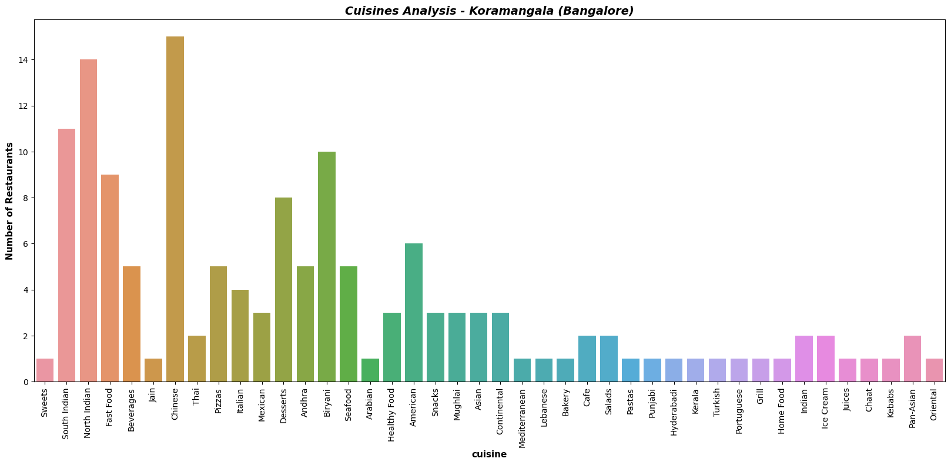
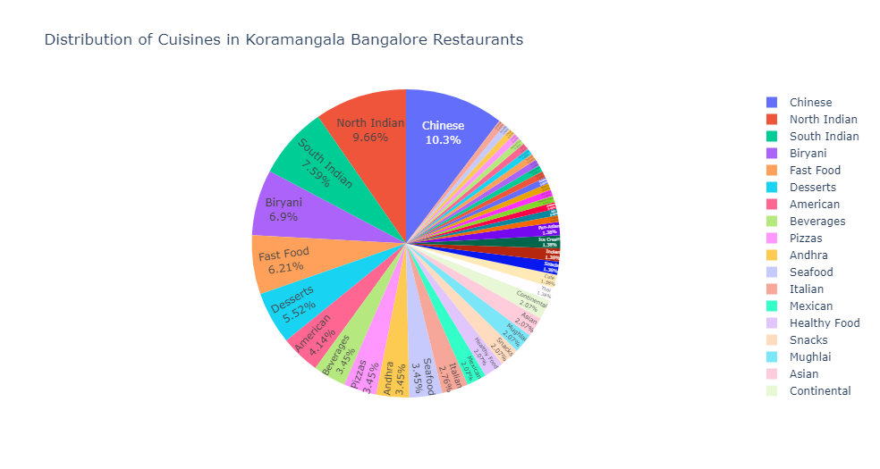
Distribution of Cuisine in Koramangala Area :
Conclusion :
From the above Visualizations, We can say, In Koramangala Area, "Chinese“ Cuisines are dominated by around '10.3%’ followed by "North Indian“ & “South Indian“ Cuisines '9.66%’ & '7.59%’ of Restaurants respectively.
So, We can also infer that Most of the people are fond of the "Chinese“ Cuisines.

Slide 17
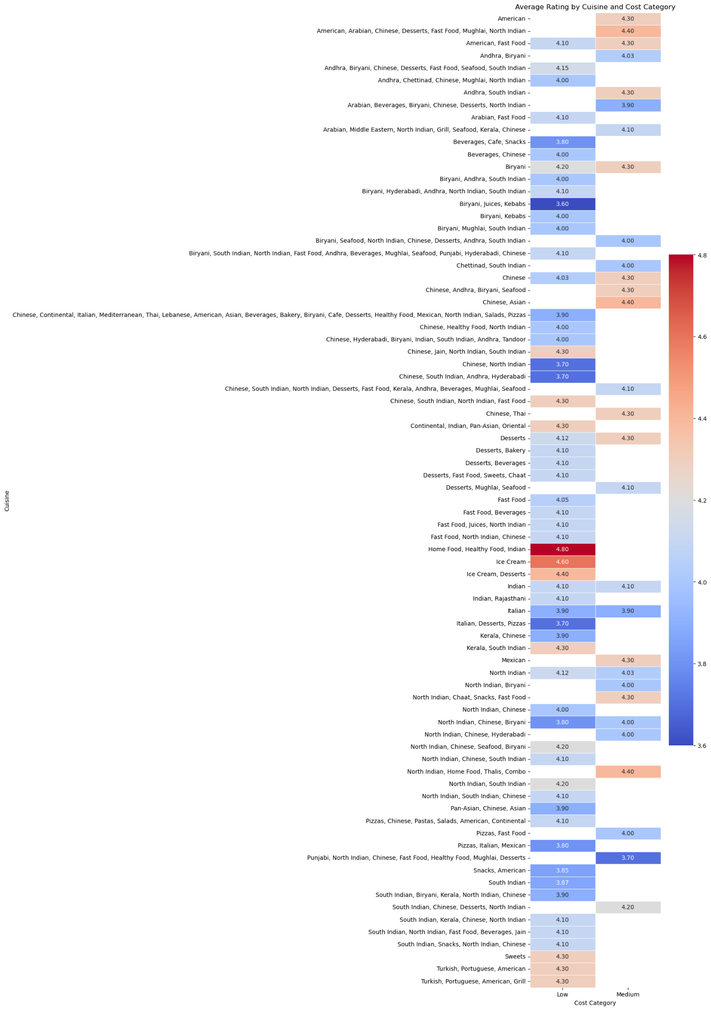
Average Rating by Cuisine and Cost Category :
Conclusion :
The heatmap displays the average cost and rating for each cuisine in Bangalore. This analysis helps to identify which cuisines have the highest average cost and rating. This information can help customers make informed choices when deciding on which cuisine to order.

Slide 18
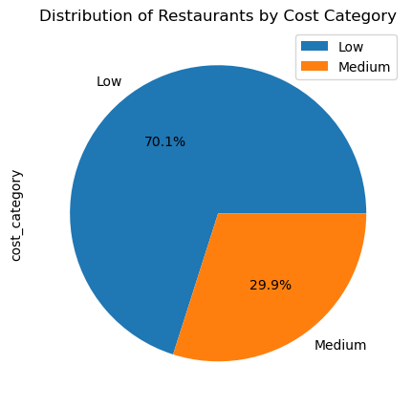
Distribution of restaurants by cost category :-
Conclusion :
The pie chart displays the distribution of restaurants based on their cost category. The analysis helps to identify the percentage of restaurants that fall under each cost category. This information can help customers choose restaurants based on their budget.

Slide 19
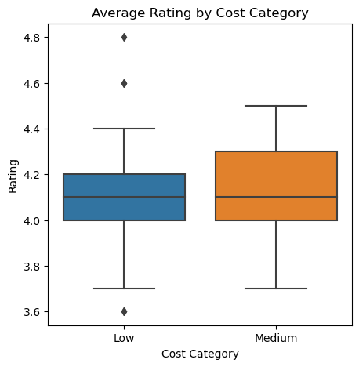
Average Rating by cost category :-
Conclusion :
The box plot displays the average rating by cost category. This analysis helps to identify which cost category has the highest average rating and which has the lowest. This information can help customers choose restaurants based on their budget and still enjoy good ratings.

Slide 20
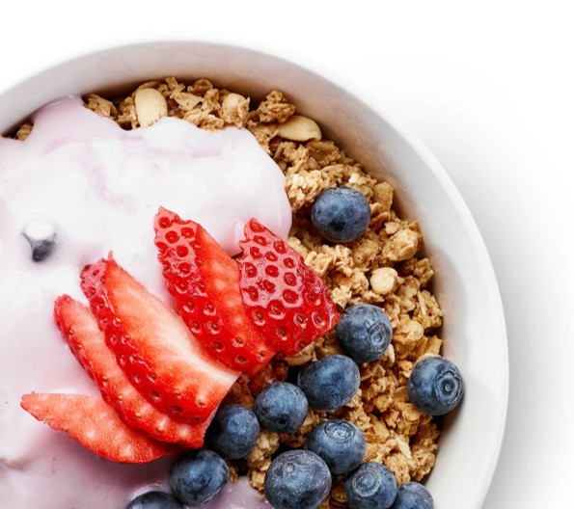
CONCLUSION
Overall, the analysis performed in the project provides useful insights for customers in Bangalore who use Swiggy for food delivery services. The information can help customers make informed choices on which cuisine, restaurant, and location to order from based on their budget, preferred rating, and location.

Slide 21
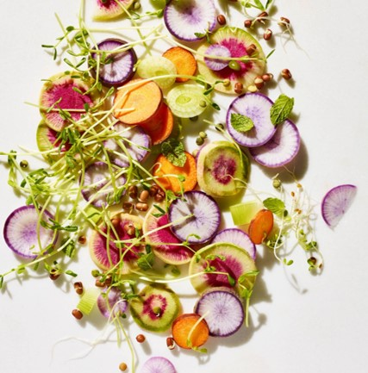
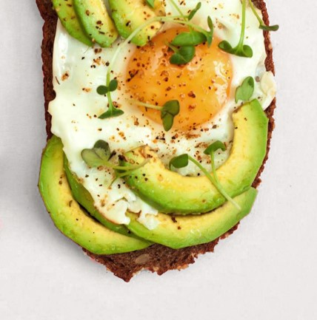
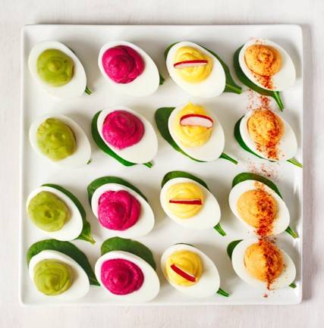
THANK YOU

